Slide 1
HTML Tag Presentation
Presented By James Feeney

Slide 2
Previously on Our Presentation
<img> allows the developer to place an image and control the size to their site
<video> deploys a video file (NOT Youtube) to their site
-GIFs are a great example of the type of video file you can post
<audio> deploys a audio file that can be played by a user
<iframe> deployed embedded links to a site
-This can be youtube embedded links or any other site that supports
embedded links

Slide 3
Sectioning and Structuring
<header> tags are used to distinguish heading tags from the rest of the content
<nav> tags are used to set navigation links to a site
-Used these to easily navigate through the page or to go to a different page
<main> tags contain the main article tags for the project
-<article> tags are independent content with their own headers, body text etc
<aside> tags adds content that is meant to go alongside main content
<footer> tags are used to add footers for document sections

Slide 4
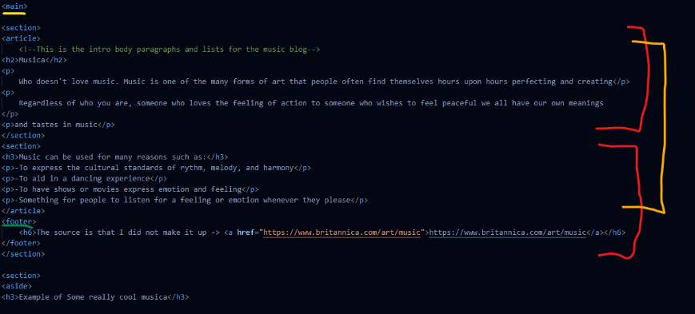
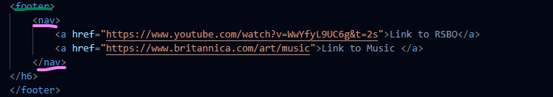
<main> Yellow
<section> Red
<article>Orange
<footer> Green
<nav> Pink

Slide 5
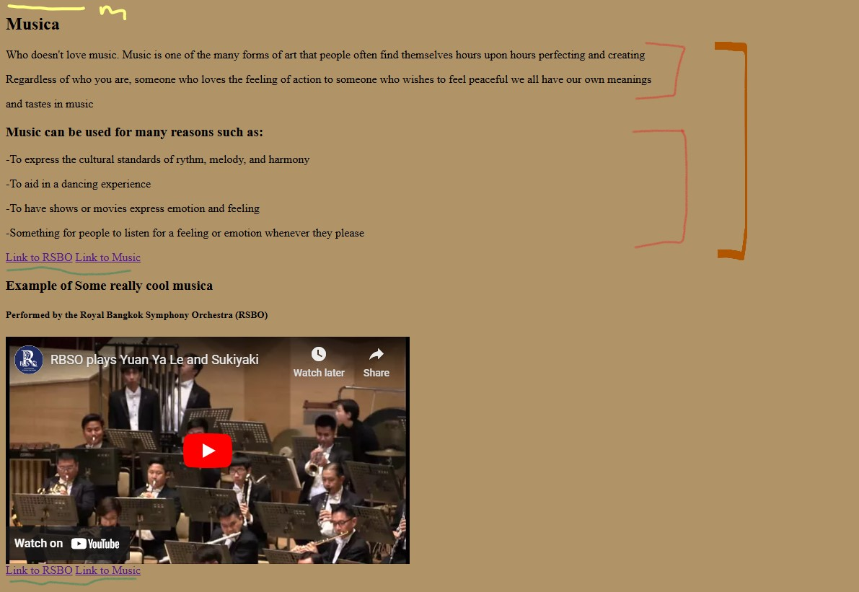
End Result

Slide 6
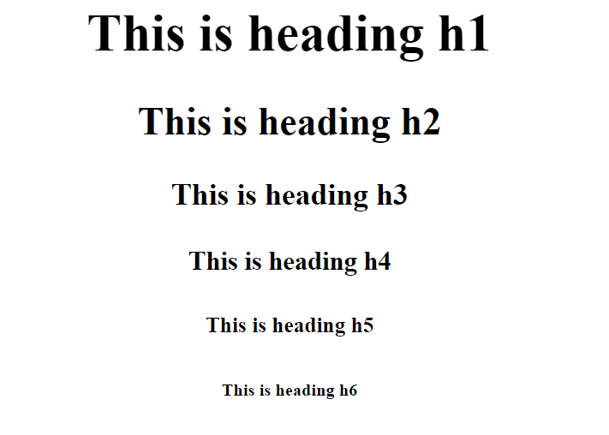
Other tags from Sectioning and Structuring
<aside> adds content to the article without disrupting the main flow, like ‘alongside’ the original content
<h1->h6> are the different title or headings to add to the site. The difference between them are that the higher the number the lower the size is for that header
Different Header Sizes Comparison→

Slide 7
Forms and Inputs
<select> tag creates a drop down list, mainly for a form to collect user inputs
<textarea> tag provides the text boxes
-intended for long inputs like a review or comment
<fieldset> tags group the related elements from a form
-<legend> tags that define the caption for the fieldset
<button> pretty straightforward, adds a button to the drop down list
Notes:
All of this entire section is credited to thee Max from the hit team, team 4

Slide 8
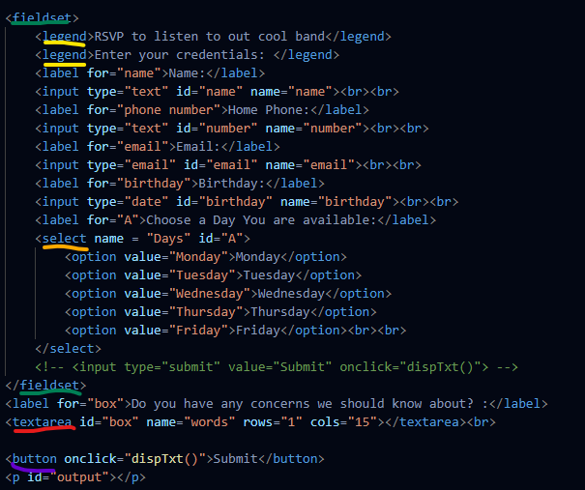

Slide 9
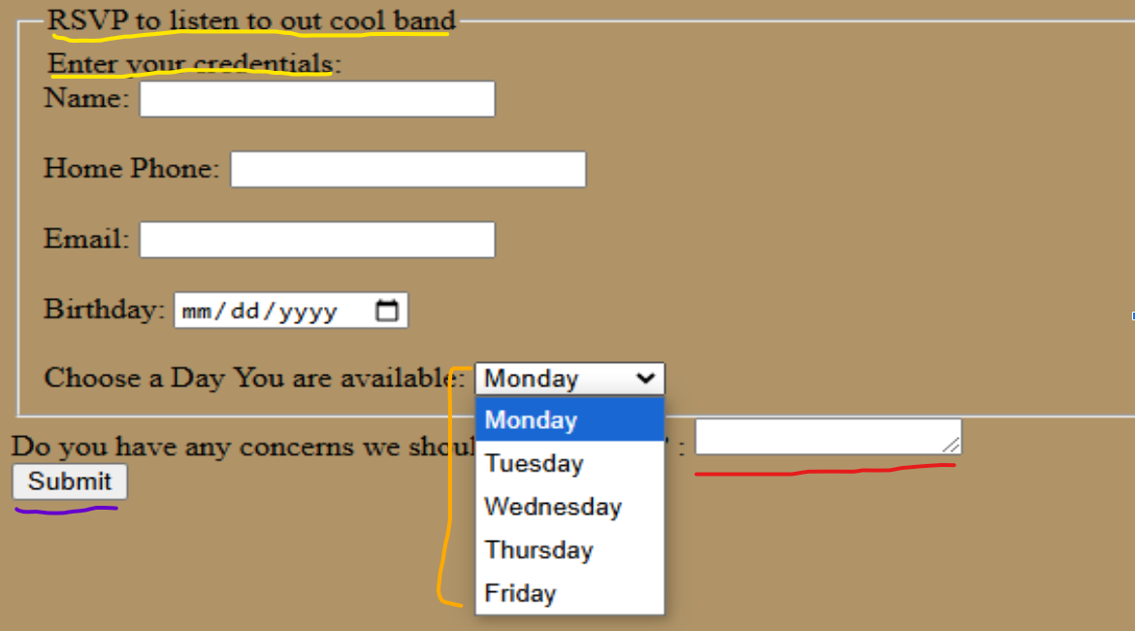
<fieldset> = everything here
<legend>
<select>
<textarea>
<button>

Slide 10
Other tags from Forms and Inputs
<input> tags set the textboxes for users to insert info
-input tags are intended for a few worded answer like names, phone etc
<form> creates an HTML form for the user input, used to collect information that the visitors may provide
<label> associate a text label for each inputs
-if you wanted a name input you type <input type="name">
<option> tags define an ‘option’ or item in the <select> elements
-In the example you saw the days of the week as options for the user to select

Slide 11
Thank You
For Your Attention!

